Slide 1

CPM® Informational
Open Houses
Nemmie Stieha | Statewide Facilitated Training Program Manager
cpm@dhr.Idaho.gov

Slide 2
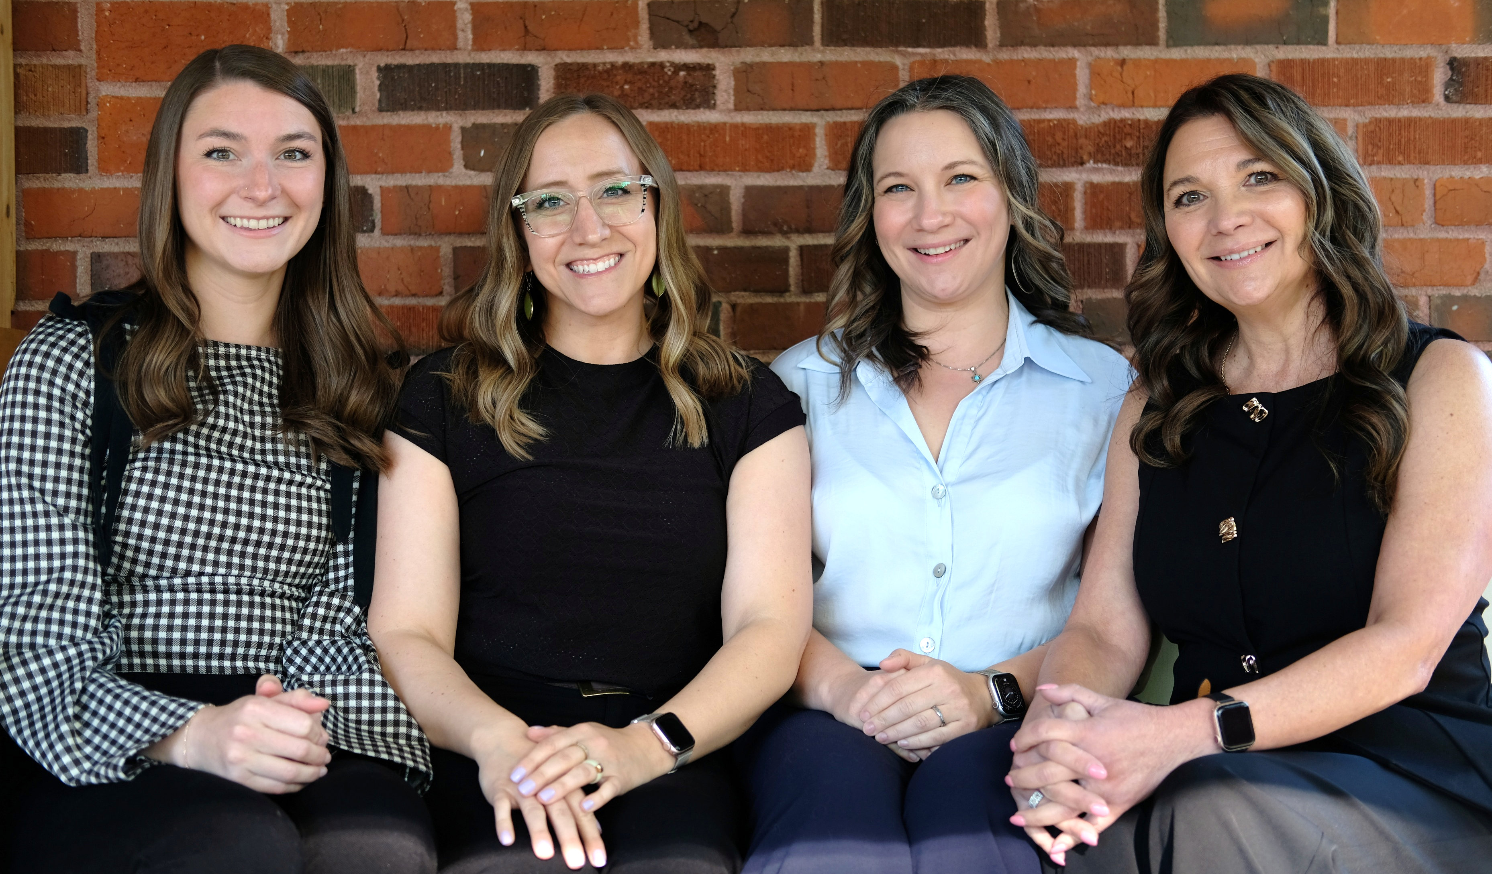
Meet the CPM® Program Team
Ali Weimer, Trainer
Kat Martin,
Trainer
Nemmie Stieha,
Program Manager
Sheryl Nikkila,
Senior Trainer

Slide 3
What is CPM®?
A nationally recognized development program for public sector professionals
Builds effective, ethical, results-driven managers
Strengthens leadership, management, and problem-solving skills through real-world application, collaboration, and continuous improvement
Helps agencies develop capable leaders
Succession planning for State of Idaho leadership.
Notes:
The Certified Public Manager (CPM) Program is a comprehensive, competency-based training program used across the country to elevate leadership capacity within government agencies. Participants learn practical tools they can immediately apply at work, and agencies benefit from increased efficiency, stronger collaboration, and better service delivery. CPM helps emerging and current leaders step into higher levels of responsibility with confidence, skill, and a clearer understanding of effective public management.
We like to think of this program really as succession planning for state of Idaho leaders building the future of what our state looks like.

Slide 4
Program Structure Overview
Year 1: January - December | Year 2: January - June
Attend two full-day classes per month. Attend office hours once or twice per month. Submit ten portfolios on CPM® Competencies | Complete all Capstone requirements Attend six hours of continuous education per month (up to four hours can be office hours) Submit four portfolios on CPM® Competencies Attend graduation
Notes:
Reviewing program structure.

Slide 5
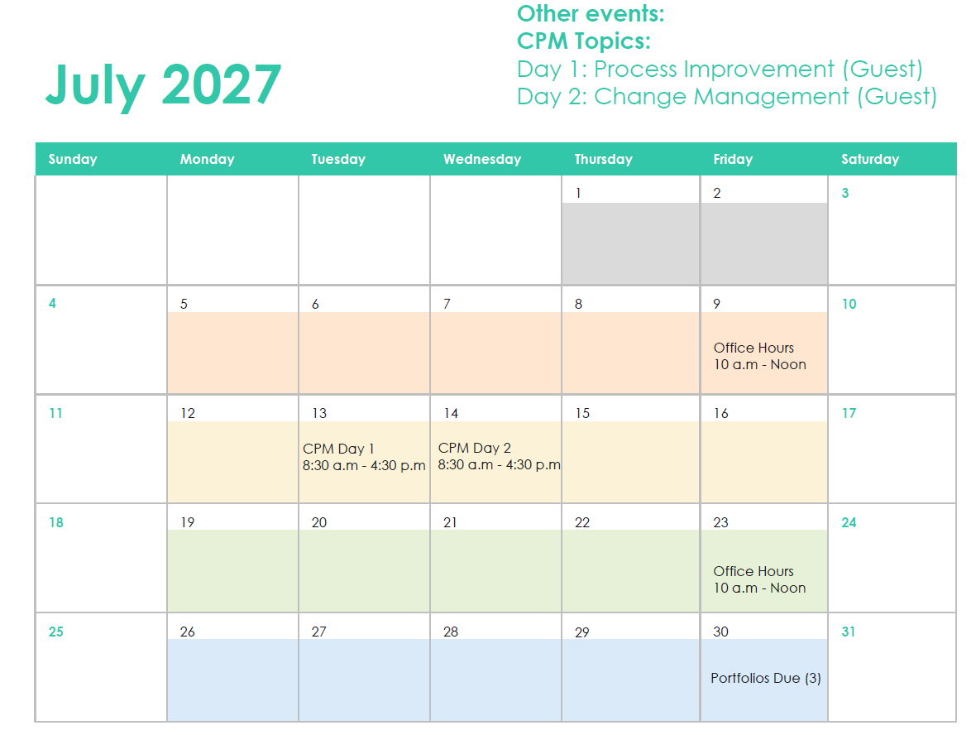
What a typical month of CPM looks like
Track 1
  Day 1: Process Improvement
  Day 2: Change Management
  Office Hours – Micro-Learning
  Office Hours – Portfolio work
Notes:
Example month in CPM

Slide 6
Capstones: Purpose, Timeline, Expectations
What is a CPM Capstone?
How do capstones benefit agencies? (real-world improvements, innovation projects)
When do participants begin planning their capstone?
  Milestones and deadlines throughout the program
What are the Capstone presentation expectations at the end of the program?

Slide 7

Expectations for Agencies and Supervisors
Support participants with time and workload
Encourage applying CPM concepts to agency challenges
Provide access to data or process owners for capstones
Engage in periodic check-ins
Participate in portfolio and capstone reviews/presentations
Serve as thought partners for assignments when appropriate

Slide 8
Participant Expectations
Attend all scheduled classes
Professional behavior and collaboration
Complete all assigned work
Commitment to implement learning

Slide 9
Application and Enrollment Process
Eligibility
Public sector employees seeking to grow in leadership and management
Application steps
Go to CPM.Idaho.Gov > Program Enrollment
Obtain supervisor approval
Complete the online application
Submit all required information
Key dates
Application window: Monday, August 17 – Friday, September 25 at 5 pm MST
Agency Approval: September – November 2
Cohort Selection Notifications: by December 1, 2026
Notes:
The application process is designed to ensure participants are ready for the commitment and that agencies can support engagement. Applicants complete a short online form, confirm supervisor approval, and provide basic information about their role. Once the application period closes, the CPM team reviews submissions and notifies selected participants. It’s helpful for supervisors to discuss expectations early—especially around time management and capstone support.

Slide 10
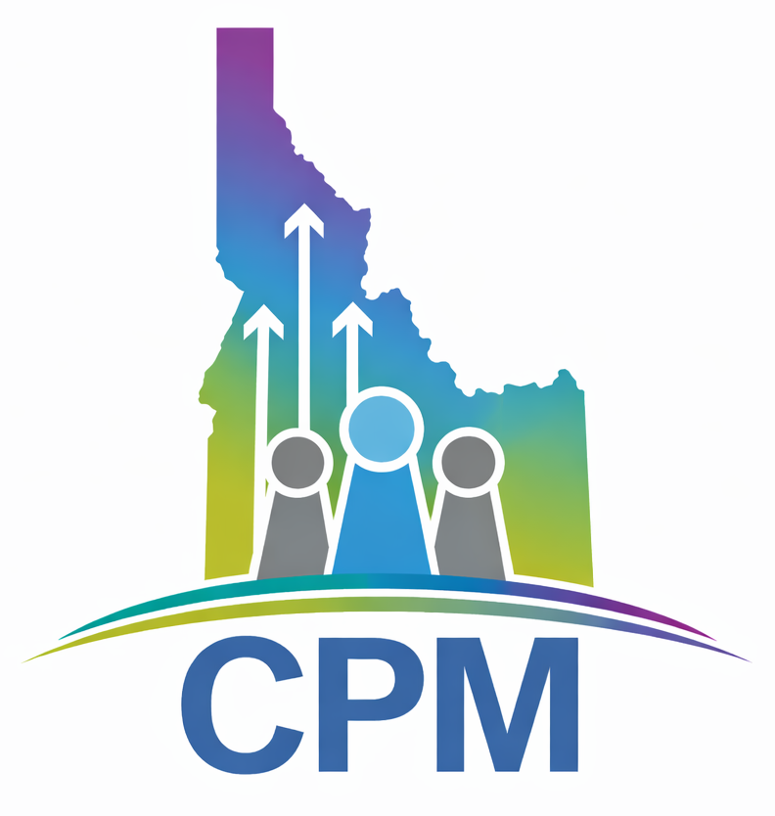
Link in chat!
Visit CPM.Idaho.gov to apply
CPM Open House Attendance Form
What's next?
Notes:
QR code removed.
Drop in chat:
https://cpm.idaho.gov/
CPM Open House Informational Session Attendance
https://app.smartsheet.com/b/form/01a000d0bbd671ad8b3ac7461244adff

Slide 11
Q&A
Other questions?
Please email CPM@dhr.Idaho.gov

